Slide 1



MAX HEALTHCARE LTD
VR Capitol Hospital, Jalandhar
VASTU STRATEGIC ANALYSIS
Recommendation on-15th July, 2026
VR/195/26

Slide 2
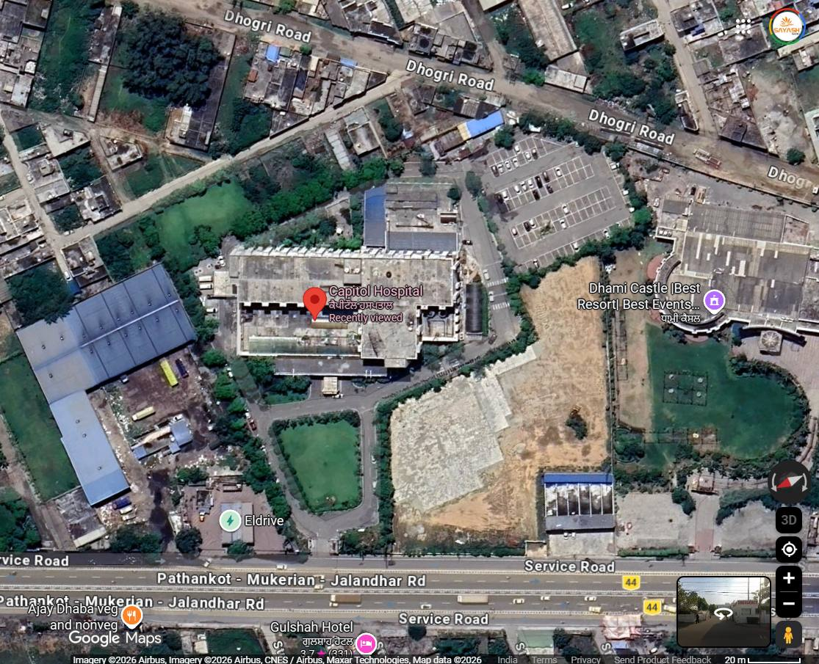

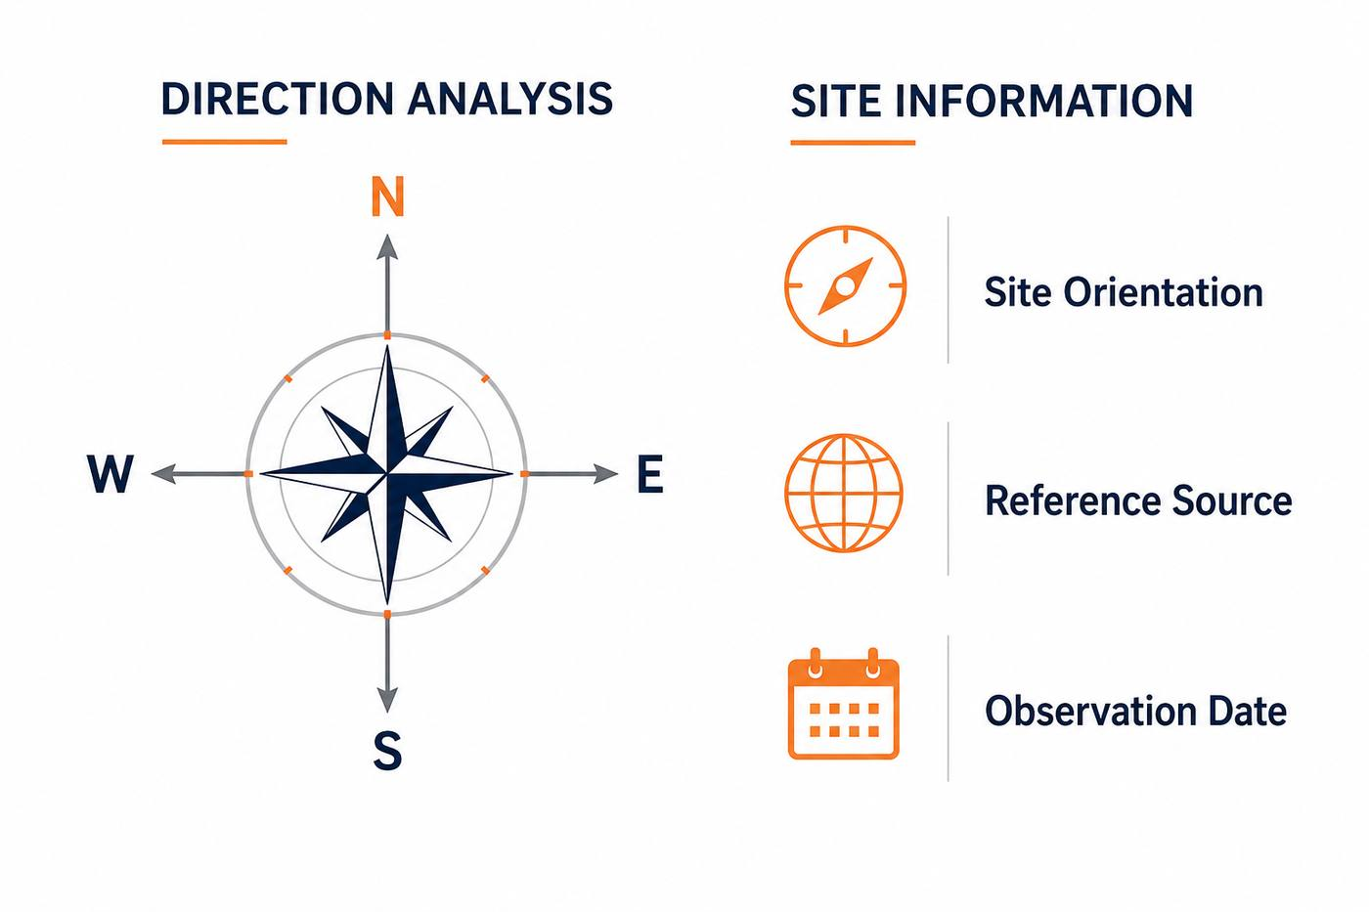
NORTH ALIGNMENT
PROJECT:
Capitol Hospital, Jalandhar
02
DIRECTION ANALYSIS
The site is North-West facing.
Tap Here to Open the Location
SITE INFORMATION
Site Orientation
North-West Facing
Reference Source
Google Map
Observation Date
July 2026
SATISH GUPTA & YASH GUPTA
(VASTU CONSULTANTS)

Slide 3
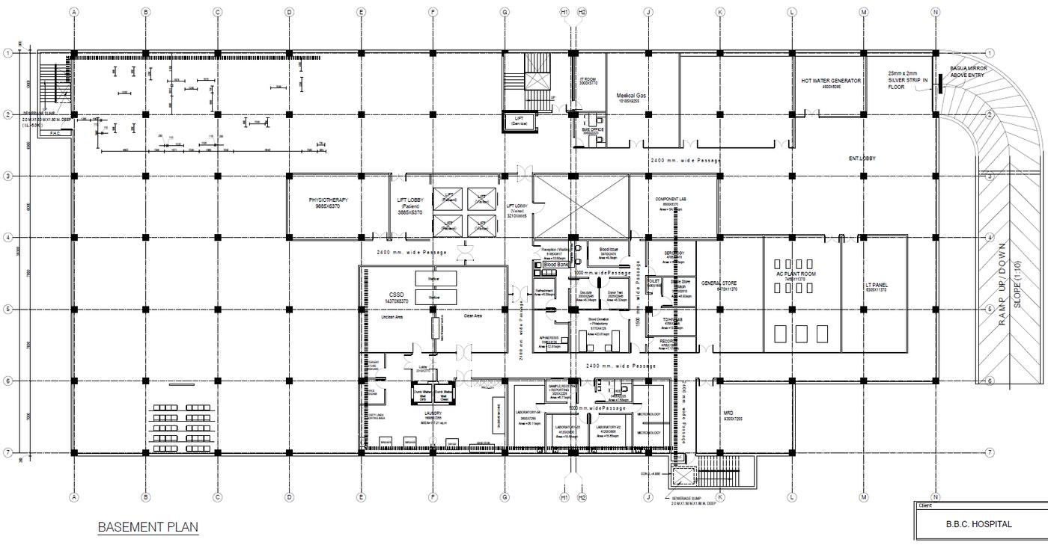
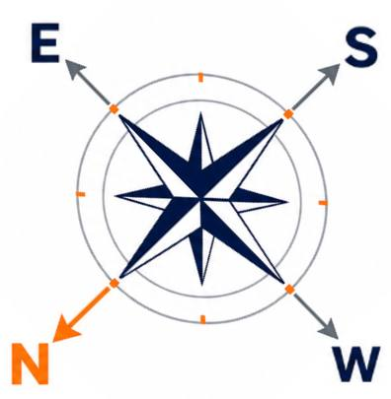
KEY VASTU CONSIDERATIONS
PROJECT:
Capitol Hospital, Jalandhar
03
BASEMENT FLOOR PLAN OBSERVATION
The ramps have been planned in the South-West zone, which is not recommended.
The Lift Core is located in the Brahmasthan (central zone), which is not considered appropriate.
The electrical services have been planned in the South-West zone, which is not the recommended location.
BASEMENT FLOOR PLAN
SATISH GUPTA & YASH GUPTA
(VASTU CONSULTANTS)

